Slide 1
Topic: Multiplication
EQ: What are Strategies I can Use to Multiply Integers?
Year 7 Mathematics
Mrs Parlevliet

Slide 2
Contents
Glossary or Formula Page
Page
Date
Essential Question
24
7
30
Word or Formula
Definition or Example

Slide 3
Tasks
24
7
30
Topic
Essential Question
Questions
Notes
Summary
1
2

Slide 4


Five Questions (LHS)
Topic: Multiplication
EQ: What are strategies I can use to multiply integers?
Date: 24/03/2021
Write $\frac{9}{7}$ as a mixed number.
$6−10=$
List in descending order: 5, 7, -9, 11, -4, 3, -8
Solve $5×4$
Mathspace fruit question…
This Photo by Unknown Author is licensed uder CC BY-ND
Notes:
105.43
e
0.5
$\frac{1}{5}$
Amelia took 250 seconds to finish the race.

Slide 5

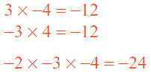
24
7
30
Topic: Multiplication
Date: 24/03/2021
EQ: What are strategies I can use to multiply integers?
What is an integer?
Integers are like whole numbers, but they also include negative numbers.
The two strategies that we learned yesterday, the array strategy and the area model strategy can be used to multiply integers.
What strategies can be used to multiply integers?
However before we dive into using the array strategy or area model strategy we need to know what happens to the product when we multiply with negative factors.
What are the rules for multiplying negative values?
If we multiply an even number of negative values, the product will be positive.
If we multiply an odd number of negative values, the product will be negative.
WICOR

Slide 6


Slide 7
Task (LHS)

Slide 9

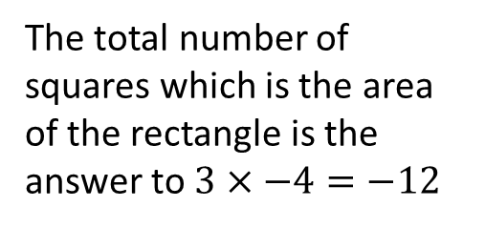
24
7
30
Topic: Multiplication
Date: 24/03/2021
EQ: What are strategies I can use to multiply integers?
Using array strategy to multiply integers.
Example 1
$3×−4=$ can be solved by drawing an array with 3 rows of 4 squares.
Factors, numbers being multiplied
-4
The total number of squares which is the area of the rectangle is the answer to $3×−4=−12$
3
Product, the answer to a multiplication, is negative because we have an odd number of negative values
$$3×−4=−12$$
WICOR

Slide 10

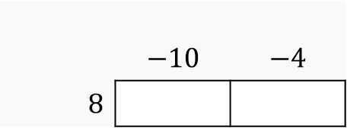

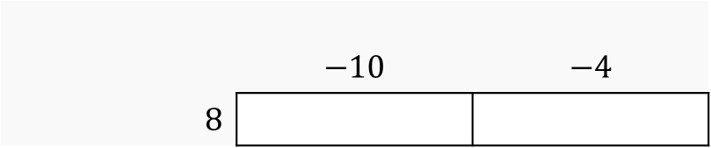

24
7
30
Topic: Multiplication
Date: 24/03/2021
EQ: What are strategies I can use to multiply integers?
What is the area model strategy?
The product of two numbers can be found by using the distributive law.
Example 1
$$8×−14$$
1. We can write $8×−14$ as $8×(−10−4)$ because $−14=−10−4$
2. We then set up rectangles to work out the area of them like this.
 | $$−10$$ | $$−4$$
$8$
3. We work out the area of the rectangles by multiplying the lengths with the height.
 | $$−10$$ | $$−4$$
$8$
$$8×−10=−80$$
$$8×−4=−32$$
WICOR
4. Evaluate the sum of the area of the rectangles, $−80+−32=−112$.
This means that $8×−14=−132$

Slide 11

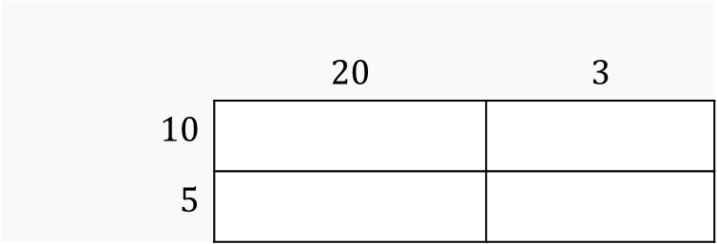








24
7
30
Topic: Multiplication
Date: 22/03/2021
EQ: What are strategies I can use to multiply whole numbers?
Using the area model strategy to multiply integers
Example 2
$$15×23$$
$15×23$=
$$(10+5)×(20+3)$$
 | $$20$$ | $$3$$
$10$
$5$
$$10×20=200$$
$$10×3=30$$
$$5×20=100$$
$$5×3=15$$
$$200+100+30+15=345$$
$$15×23=345$$
WICOR

Slide 13
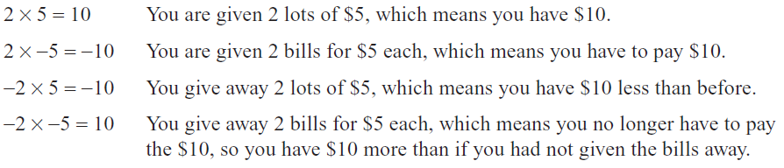
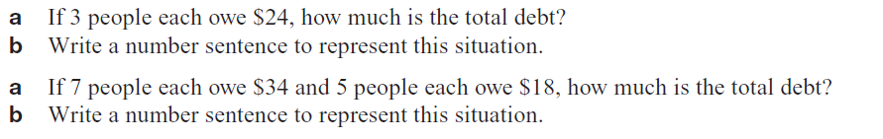
TASK (LHS)
Read the following information before the questions.

Slide 14

Write Your Summary
Write a summary that answers the Essential Question: What are strategies that I can use to multiply whole numbers?
Include an example in your answer.
This Photo by Unknown Author is licensed under CC BY-SA

